Slide 1



PHUNDEX PATHWAY TEMPLATES
Our best practice Phundex Pathway Templates give you a streamlined way to manage processes and transactions.
April 2024

Slide 2

PHUNDEX PATHWAY TEMPLATES
Transaction Pathway Templates
Asset Based Lending
Capital Raise
Business Acquisition
Property Development Funding Application to Completion
Start-up New Equity Raise
Asset Funding Application to Completion
Commercial Real Estate Acquisition (in development)
Due Diligence Process
Commercial Funding Application to Completion
SME Venture Client Assessment to Funding
Jersey Private Fund Set-UP

Slide 3
PHUNDEX PATHWAY TEMPLATES
Process Pathway Templates - Governance
Board Meeting Preparation
Financial Processes
SOC Audit Checklist
Business Risk Management Process
Investment Committee Preparation Process
Regulatory Liaison Process
Data Protection Checklist
Data Sharing & Subject Access Checklist
OneDPA Data Protection Agreement
Business Risk Assessment Process-NEW

Slide 4
PHUNDEX PATHWAY TEMPLATES
Process Pathway Templates
Financial Processes
Innovation Management System
Start-Up initial business build to Funding
Client Onboarding Process
VC & family office new deal onboarding process
Disaster Recovery Plan
HR Onboarding Process
HR Offboarding Process
Month-End Financial Processes Pathway
Environs Capital Analysis Process
HR Department Checklist
OneNDA NDA templates (updated templates and instructions)

Slide 5
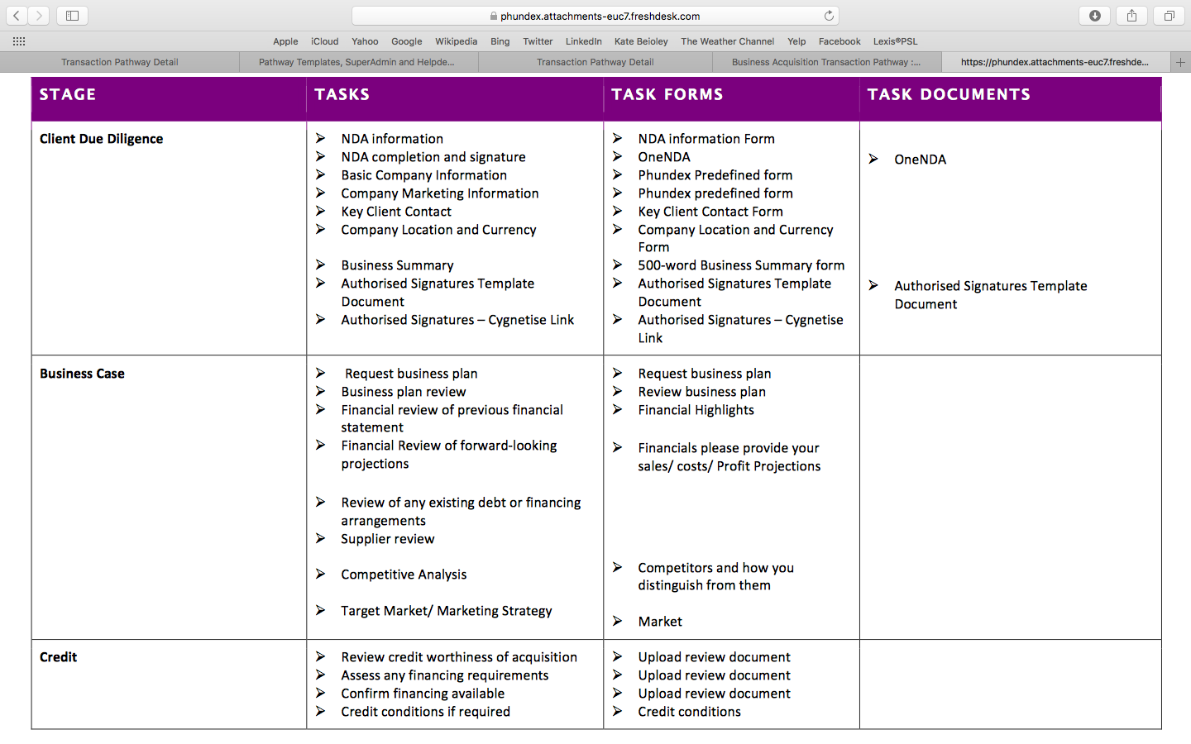
PATHWAY TEMPLATES EXAMPLE
Business Acquisition

Slide 6
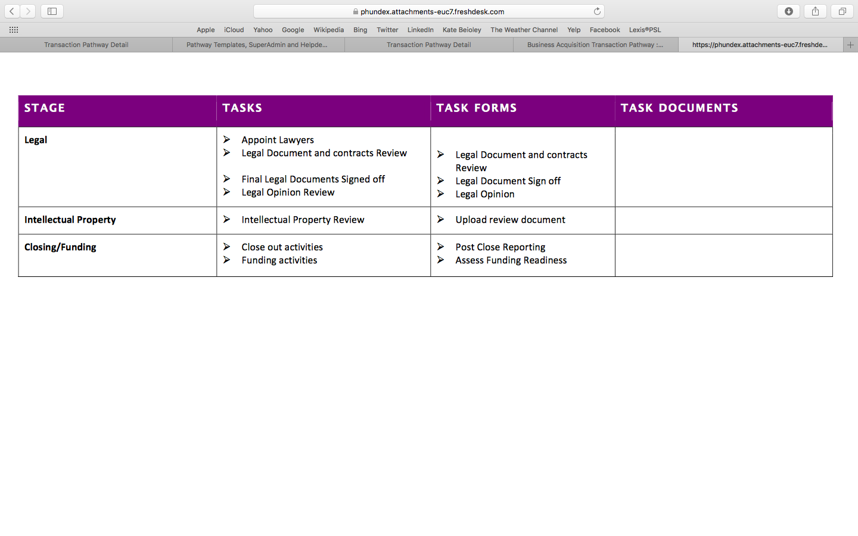
PATHWAY TEMPLATES
Business Acquisition

